Slide 1
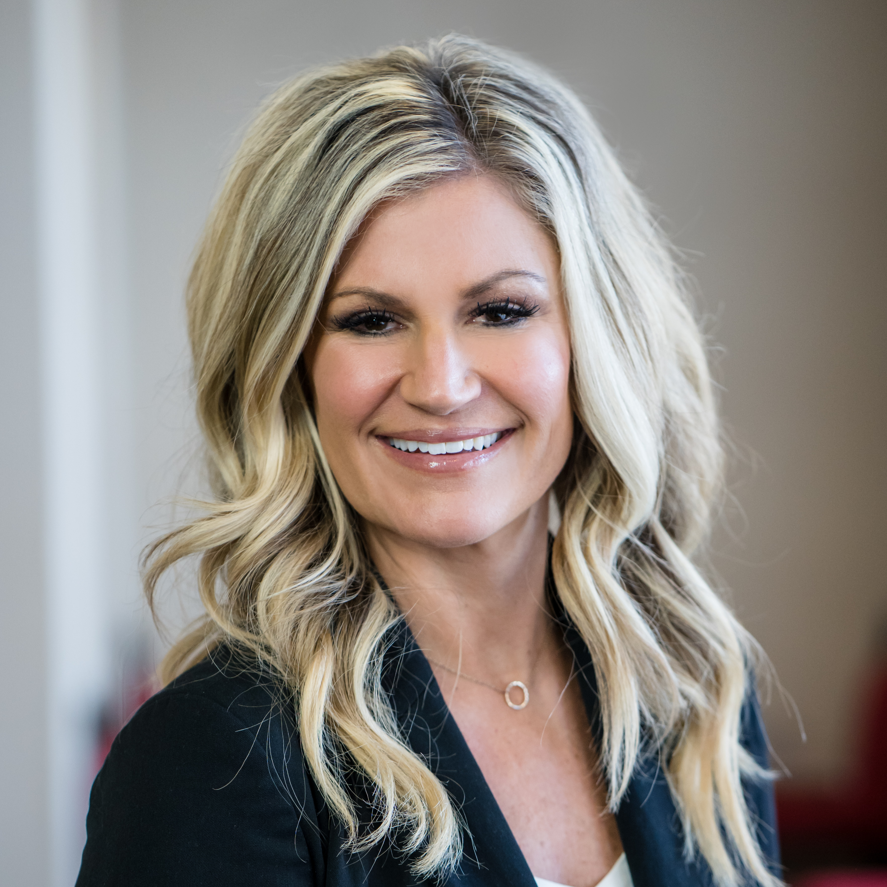
Alissa Volpi Senior Consultant
Acceleration
Email
alissa.volpi@thebridge.com
Location
Parker, Colorado
Mobile
(303) 910-5594
Alissa, a dedicated and innovative Supply Chain professional, joined The Bridge in August 2024 with 14+ years experience and a proven track record in Healthcare Supply Chain strategy, transformation, process automation/streamlining, change management, risk management, sourcing and contracting. Partners with clients to achieve their goals through collaborative relationships and tailored solutions.
EXPERIENCE
Industry Experience
Healthcare | Supply Chain | Pharmaceuticals | Technology | Real Estate | Start-Up Operations
Healthcare Sr. Consultant - Memorial Sloan Kettering Cancer Center, MD Anderson, Intermountain Healthcare, Intalere, Oregon Health Sciences University
Led comprehensive Supply Chain transformation initiatives, focusing on strategic direction, organizational alignment, role assessment, sourcing methodology, technology implementation, procurement standardization, and procedure/policy development to improve operational efficiencies and reduce costs.
Designed & led comprehensive training programs focused on Sourcing Methodology & Supply Chain Management in the healthcare sector
Specialize in sourcing & contracting strategy to seamlessly assist clients and deliver on customer satisfaction, defined improvement policies/procedures and cost reduction.
Designed and delivered tailored training courses on Supplier Relationship & Customer Relationship Management Programs, including business guidelines, scorecards, and governance policies.
Wrote sourcing procedures to align with methodology, drive operational efficiency and ensure compliance with industry standards and non-Supply Chain policies.
Developed and conducted risk assessments for supply chain to identify and mitigate risk.
Led cross-functional teams in establishing best practices, policies, and methodologies using advanced project and change management practices.
Extensive experience with business modeling, process design/documentation, lifecycle artifact development and creation of training materials/curriculum.
Demonstrated ability to partner with clients to accomplish their goals which includes achieving savings, develop and execute on strategic plans, and ensure delivery consistency across all supply chain functions.
BACKGROUND
Functional Skills
Supply Chain Process Optimization, Strategic Planning and Implementation, Organizational Alignment, Cross-Functional Collaboration, Change Management, Sourcing, Contracting, Vendor Management, Risk Management, Project Management, and Technology Integration.
Qualifications
Experienced consultant that partners with the customer to drive efficiency, enhance quality, and optimizing processes across healthcare supply chain operations. Expertise in strategic planning, organizational alignment, change management, and implementing innovative solutions to achieve operational excellence and industry standards.

Slide 2
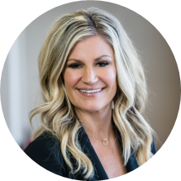

Email
Alissa.volpi@thebridge.com
Location
Parker, Colorado
Mobile
(303) 910-5594
Alissa, a dedicated and innovative Supply Chain professional, joined The Bridge in August 2024 with 14+ years experience and a proven track record in Healthcare Supply Chain Strategy, transformation, process automation/streamlining, change management, risk management, sourcing and contracting. Partners with clients to achieve their goals through collaborative relationships and tailored solutions.
Alissa Volpi Senior Consultant
Acceleration

Slide 3










 | USE OVER DARK BACKGROUND | USE OVER LIGHT BACKGROUND
STRATEGY & ADVISORY
DATA & AI
EXPERIENCES
CLOUD & PRODUCT
ACCELERATION

